Slide 1
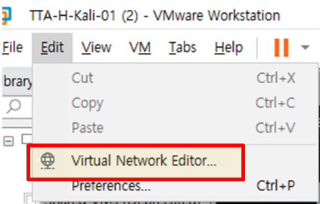
[1] Vmware Workstation: Edit->Virtual network Editor

Slide 2
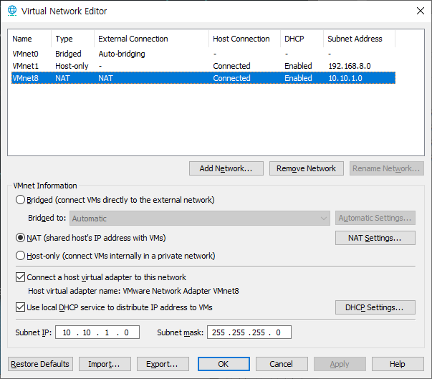
Vmware Workstation: Edit->Virtual network Editor: Subnet IP: 10.10.1.0

Slide 3
Vmware Workstation: Edit->Virtual network Editor: NAT Settings

Slide 4
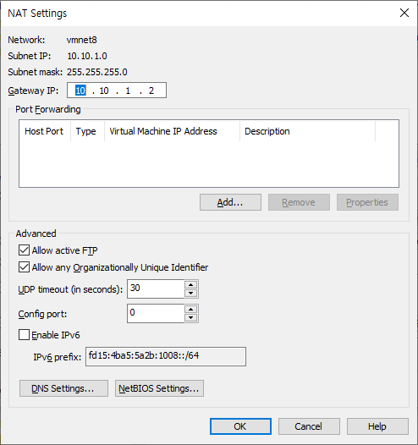
Gateway 주소

Slide 5
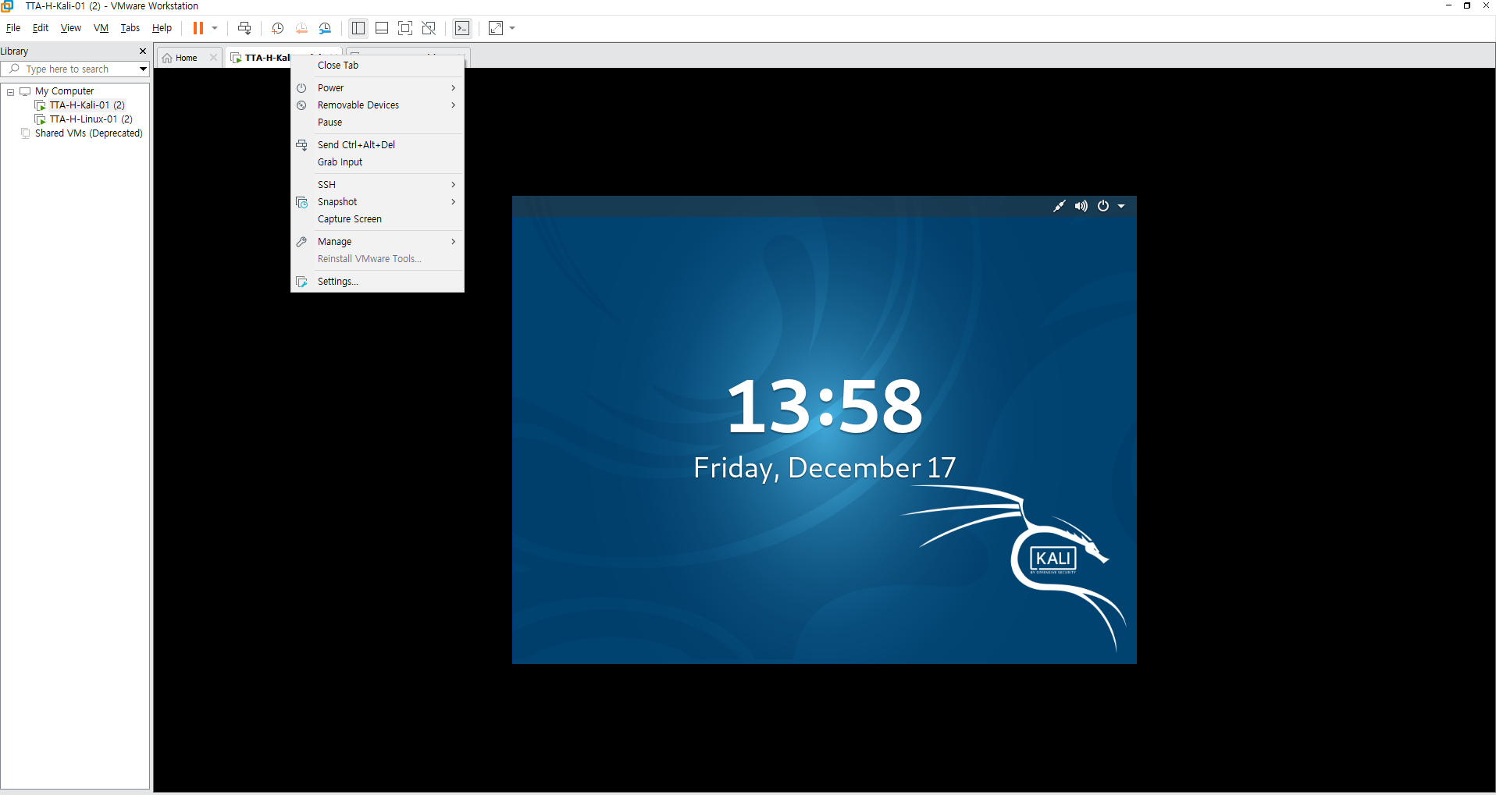
[2] Kali/Linux- 각vm마우스오른쪽-> settings

Slide 6
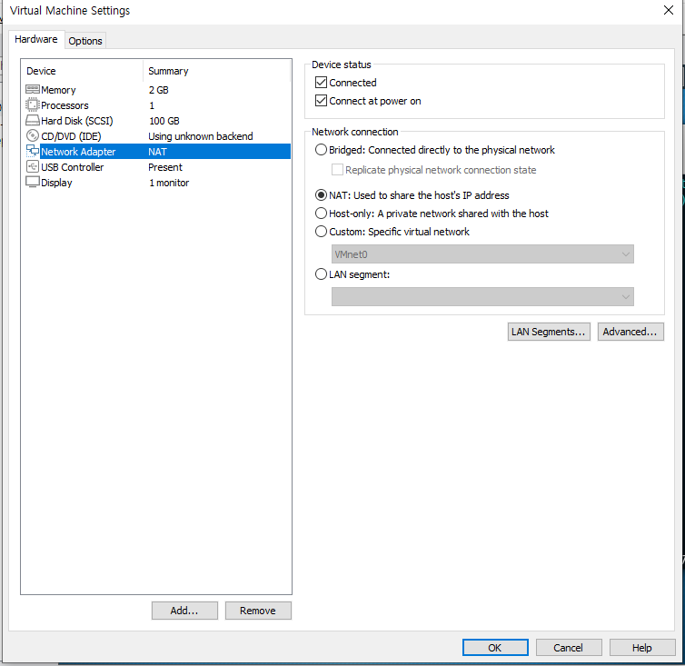
Kali/Linux- Network Adapter->NAT

Slide 7
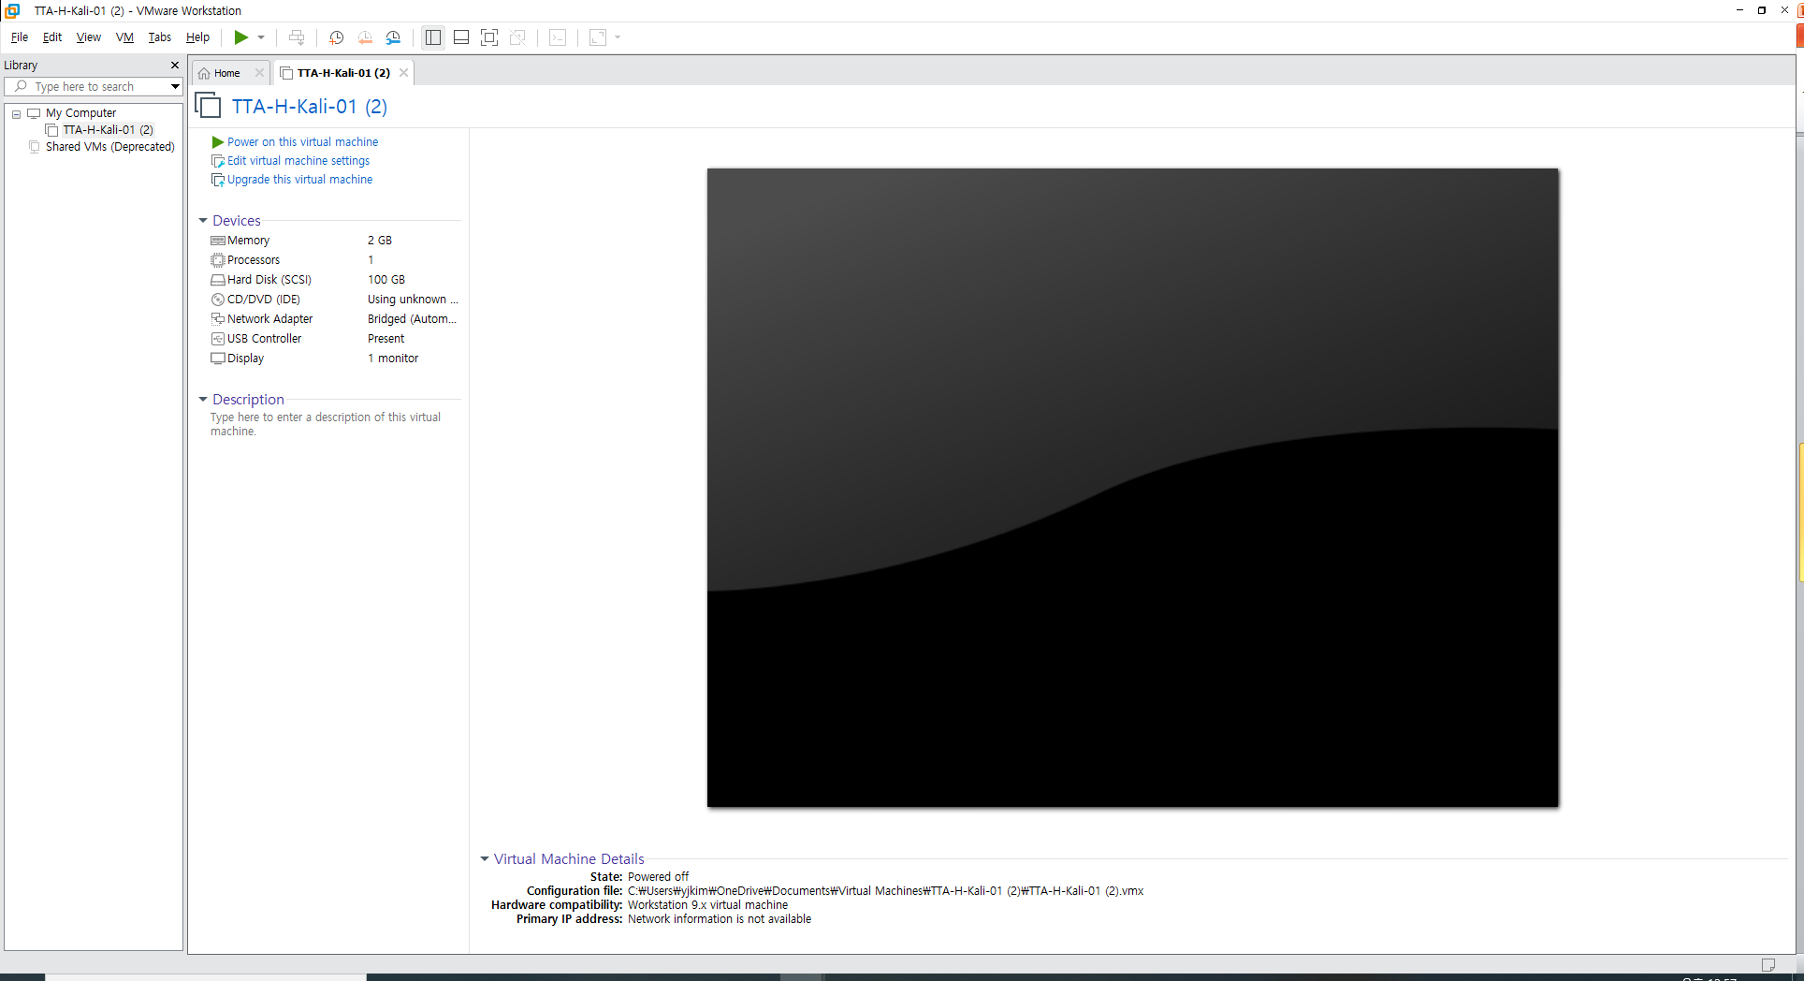
[3] Kali – Vmware 처음 화면

Slide 8
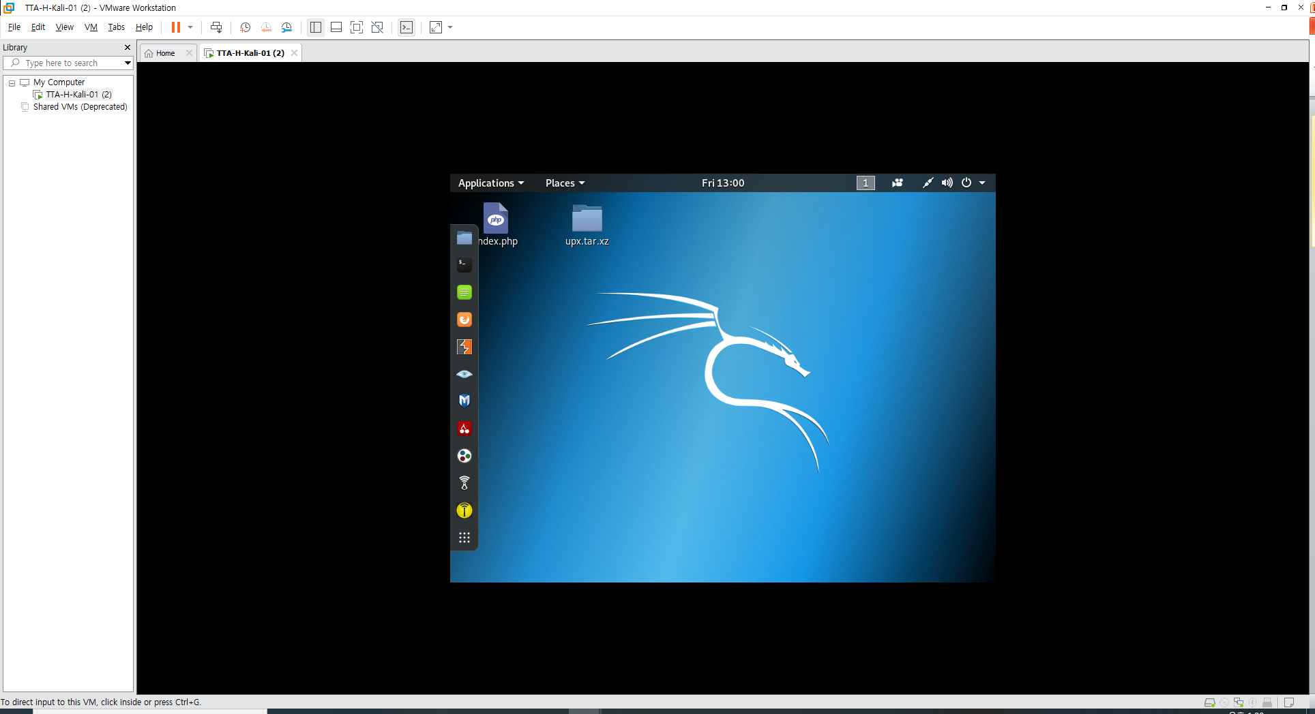
Kali –
id: root pwd: toor
로그인vmware 처음 화면

Slide 9
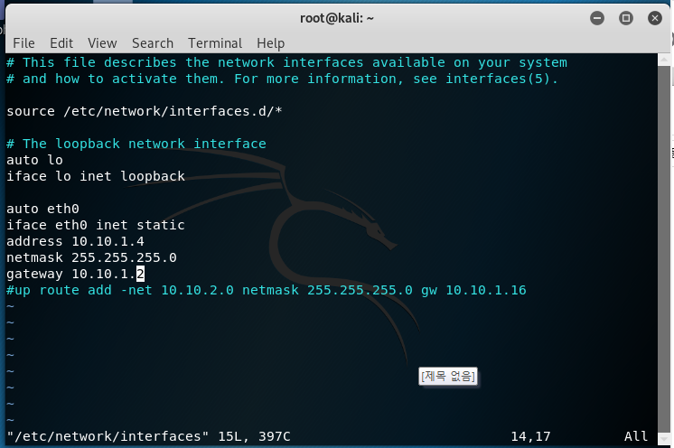
Kali- /etc/network/interfaces 마지막 route 주석 gateway 10.10.1.2

Slide 10
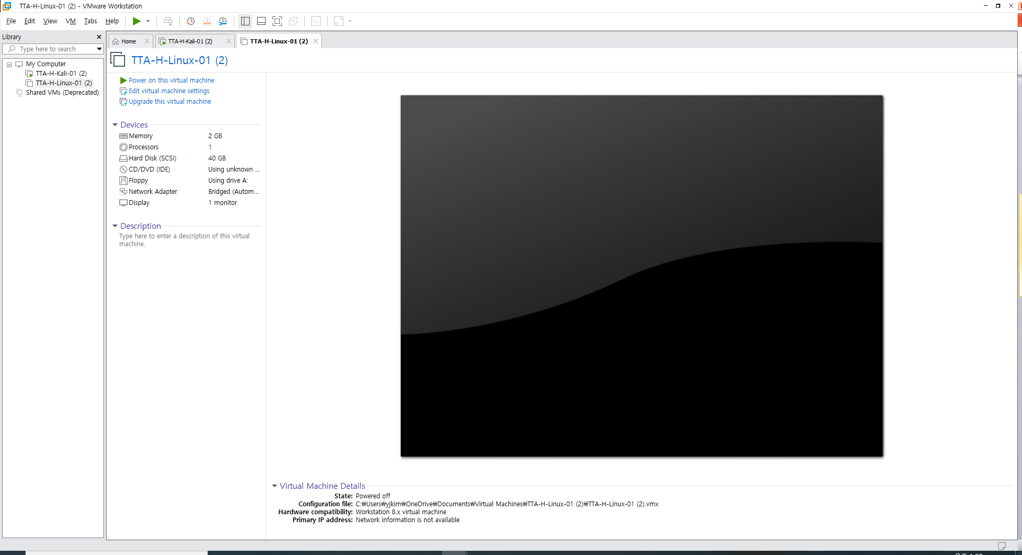
[4] Linux

Slide 11
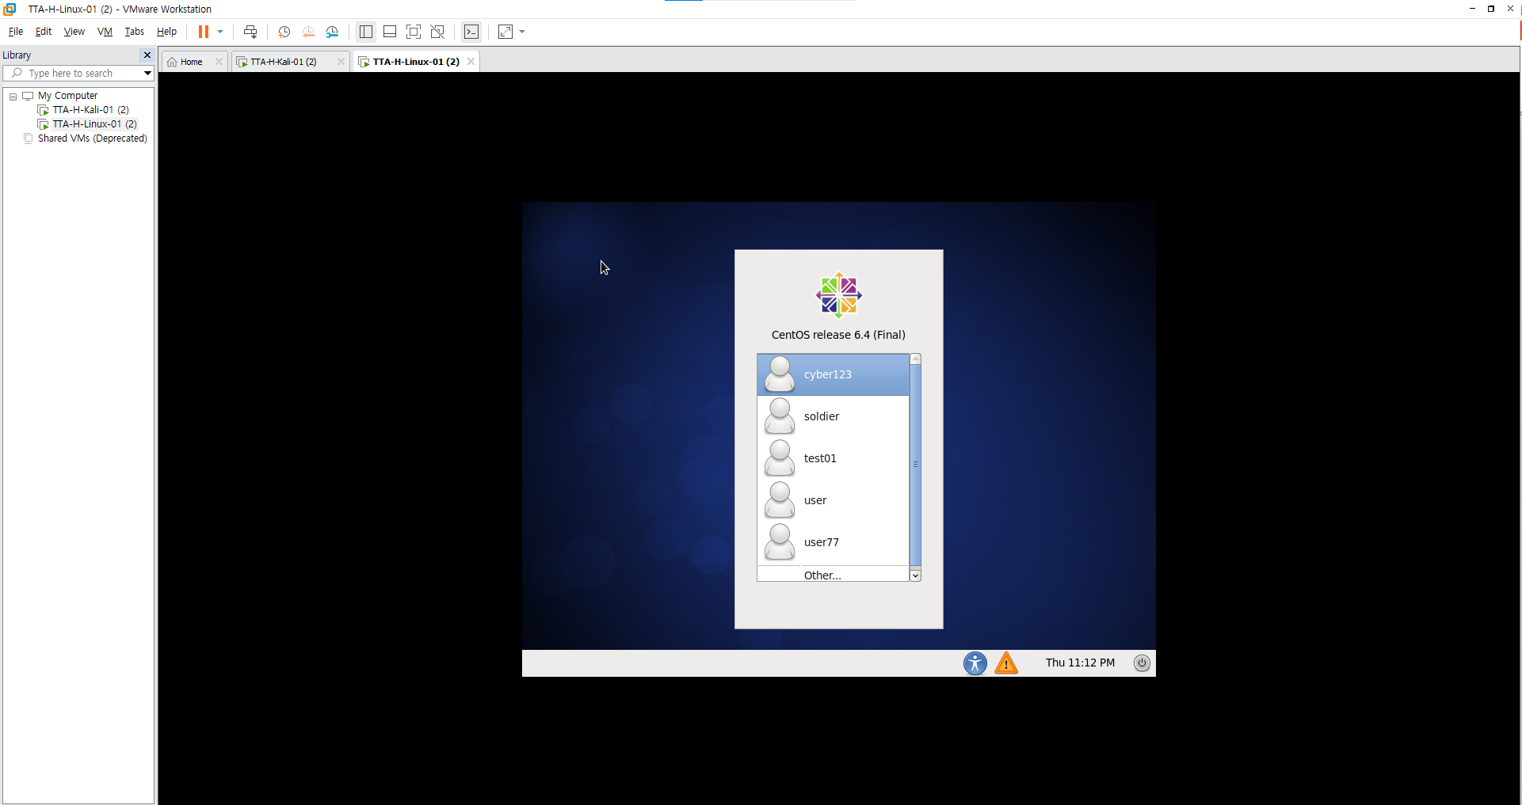
Linux –[Power on this virtual Machine]

Slide 12
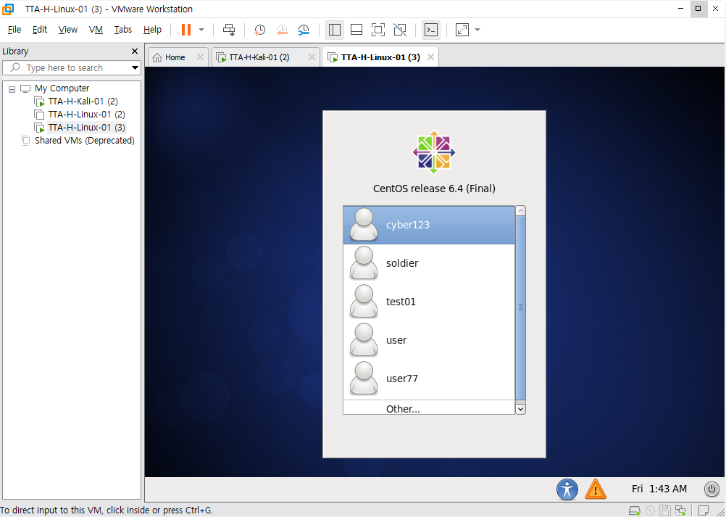
Linux – 로그인 other

Slide 13
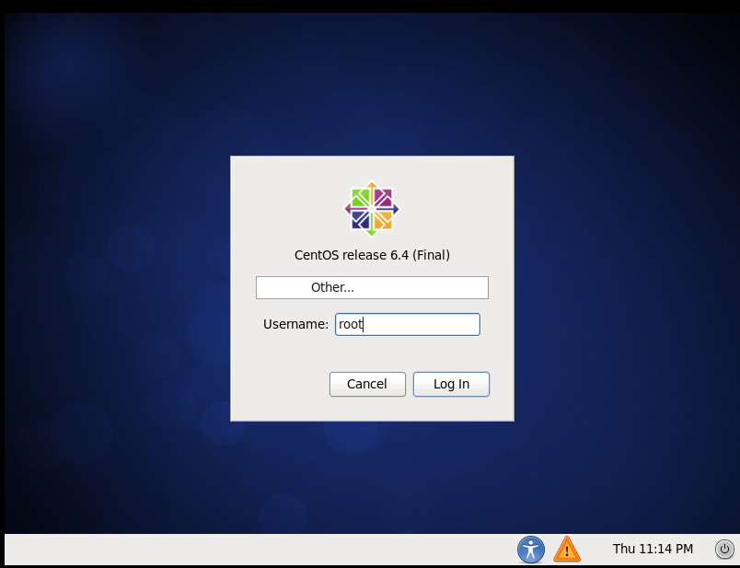
Linux – 로그인 id: root pwd: root123

Slide 14
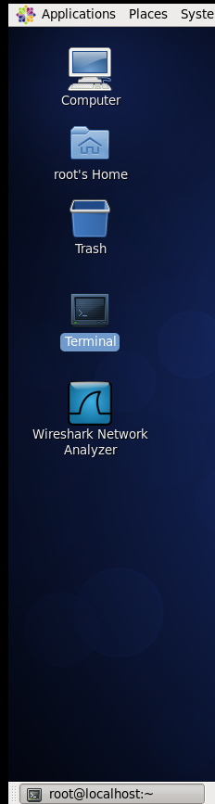
Linux- Terminal 실행

Slide 15
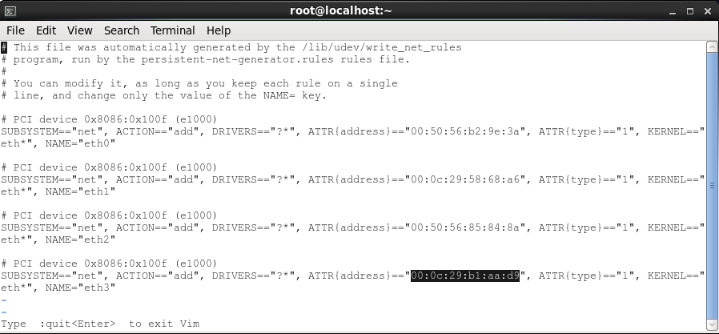
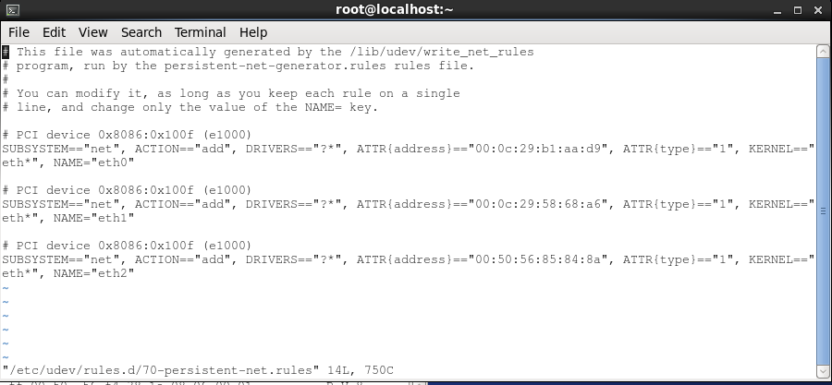
Linux- Network 설정 /etc/udev/rules.d/70-persistent-net.rules eth3 mac addr-> eth0 mac addr로. reboot

Slide 16
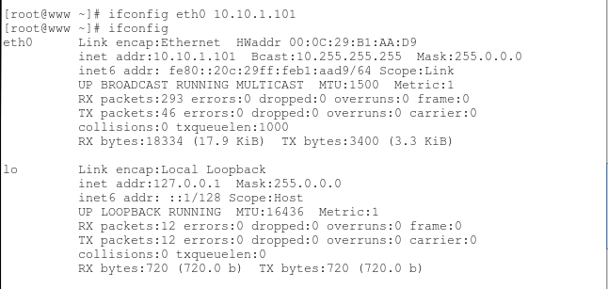
Linux network 주소 설정

Slide 17
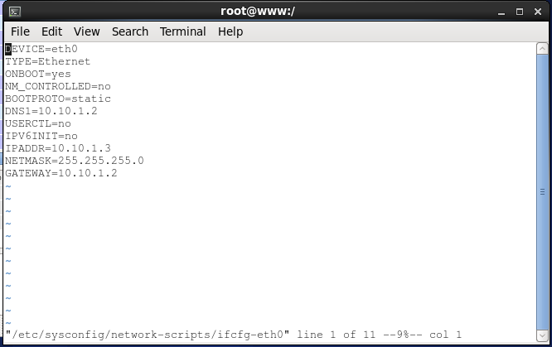
Linux- DNS1=10.10.1.2 Gateway 10.10.1.2

Slide 18
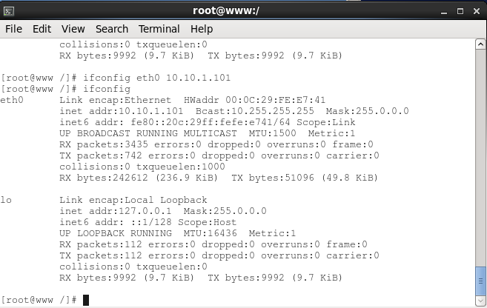
[5] Linux 주소 설정 10.10.1.101

